Slide 1
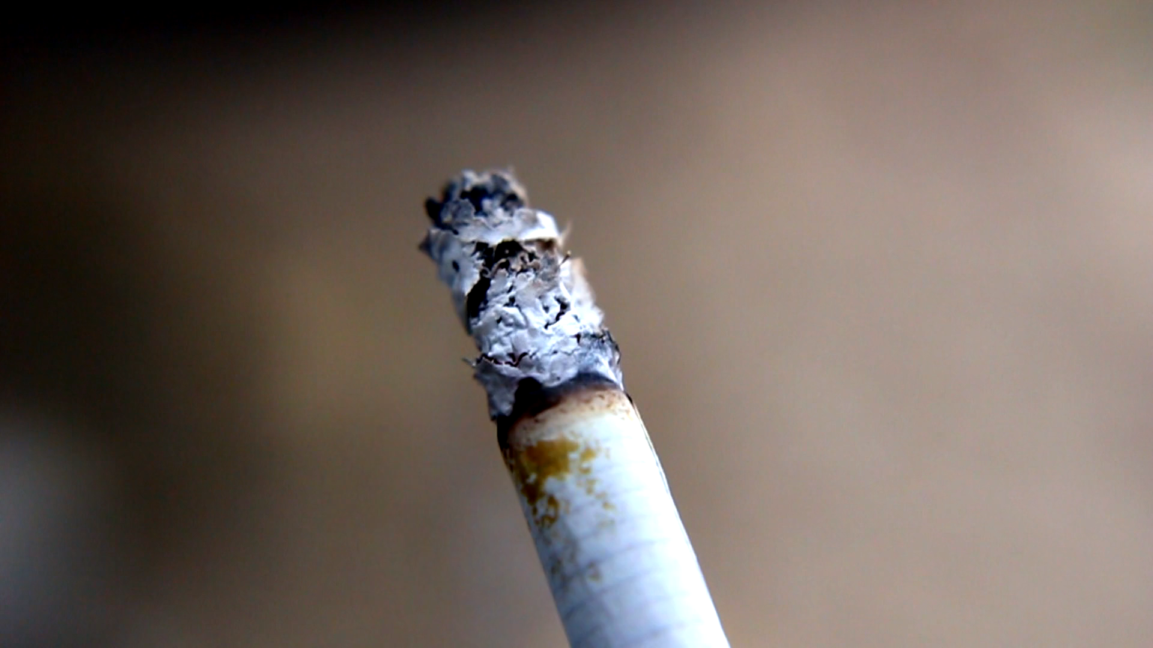
Isolation of Nicotine from Tobacco Products
Chemical properties
Effects
Source
Uses
Nicotine
Physical properties
Extraction techniques
Ass. Lec. Riham Adnan
Detection tests

Slide 2
Chemical properties
Effects
Nicotine
Source
Uses
Physical properties
Extraction techniques
Detection tests

Slide 3
Nicotine
Chemical properties
Effects
Source
Uses
Physical properties
Extraction techniques
Detection tests

Slide 4
Nicotine
Family Solanacea
The genus is Nicotina (includes about 35 species)
The most widely grown species are: N. ristica and N.toabccum.
2% to 8%
Also in tomatoes, aubergines, peppers and potatoes but at lower conc.
Chemical properties
Effects
Source
Uses
Physical properties
Extraction techniques
Detection tests

Slide 5
Nicotine
In pure state is colorless oil with b.p=247^{ە}C and density 1.0092.
On exposure to air, nicotine turns into yellow or thick brown oil.
It possesses burning taste.
Nicotine is miscible in all proportions with water and also is easily soluble in, ethanol, ether and benzene.
Nicotine easily penetrates the skin.
Source
Chemical properties
Physical properties
Effects
Detection tests
Uses
Extraction techniques

Slide 6
Nicotine
1. Aqueous solution of nicotine is strongly alkaline to litmus.
2. Nicotine forms salts with acids that are usually solid and water soluble.
3. Nicotine is oily liquid that is miscible with water in its base form.
4. The tobacco alkaloids occur in plant as salt of citric, malic or oxalic acid
Effects
Uses
Extraction techniques
Chemical properties
Detection tests
Source
Physical properties

Slide 7
Chemical structure
Nicotine
Effects
Uses
Extraction techniques
Chemical properties
Detection tests
Source
Physical properties

Slide 8
vary from person to person
depends on:
person size, weight and health,
whether the person is used to taking it.
the amount taken
Nicotine
Uses
Extraction techniques
Effects
Chemical properties
Detection tests
Source
Physical properties

Slide 9
As insecticidal.
Tobacco leaves are used as antiseptic, antispasmodic, narcotic and sedative.
Decoction of tobacco leaves is applied for muscle relaxation.
Tobacco oil is used in gout and rheumatism.
Nicotine
Detection tests
Extraction techniques
Uses
Physical properties
Source
Effects
Chemical properties

Slide 10











Dil. H2SO4
CHCl3
Nicotine
Keep the organic layer
Sodium carbonate
Take the aq. layer
Detection tests
Extraction techniques
Nicotine sulfate salt
Uses
Physical properties
Source
Effects
Chemical properties

Slide 11
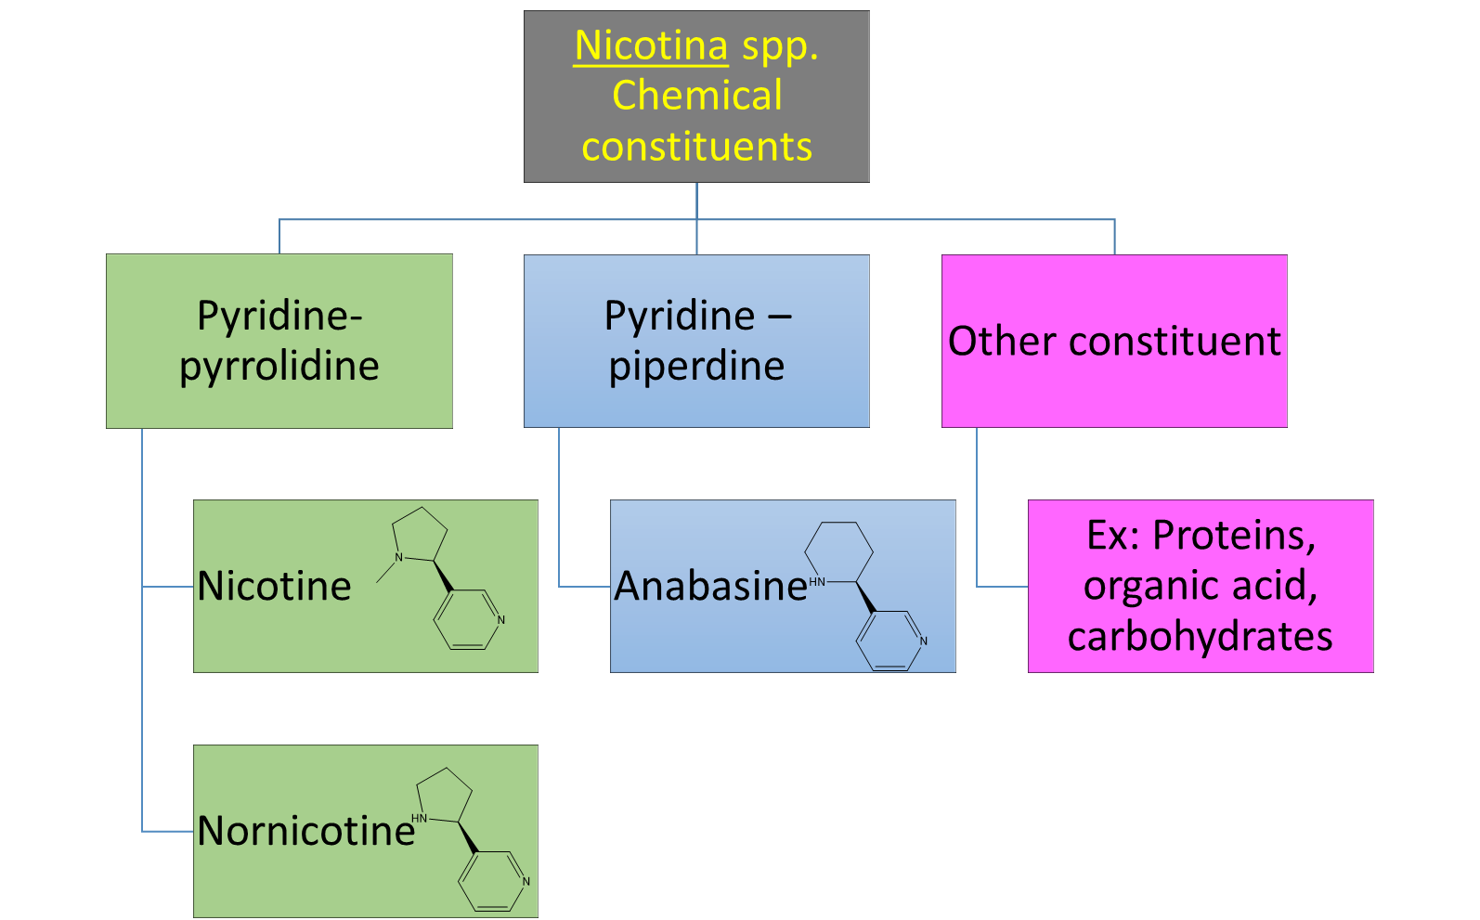
Nicotine
1. Microscopic examination:
Nicotine + mercuric chloride HgCl₂
examine under microscope flowery-shape
2. Chemical examination:
Nicotine + dragendorff reagent brown precipitate
Physical properties
Source
Detection tests
Chemical properties
Extraction techniques
Uses
Effects

Slide 12
Physical properties
Source
Detection tests
Chemical properties
Extraction techniques
Uses
Effects

Slide 13
Nicotina spp. Chemical constituents
Pyridine-pyrrolidine
Pyridine – piperdine
Other constituent
Nicotine
Nornicotine
Anabasine
Ex: Proteins, organic acid, carbohydrates

Slide 14
Nicotine
Is smoking harmful ?
Why?

